Slide 1
CLIMATE CHANGE AND HUMAN RESPONSES

Slide 2
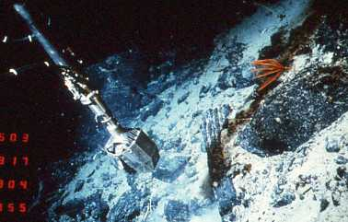

Slide 3
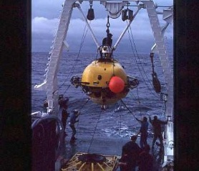

Slide 4
Climate change and the human experience
The main drivers of climate change: the astronomical cycles models and consequences
Climate change and human migration, evidence from the fertile crescent
Ocean currents, plankton and the buildup of energy the modern source of global warming
14,000 years of change in mid-Wales and Cardigan Bay

Slide 5
CLIMATE CONTROLS
Astronomical – Planetary Cycles long-term
Planet outgassing (insolation screen) Mantle main driver
Burning of fossil fuels responsible for 75% of greenhouse gas
Sun Cycles (very short)
Organic activity persistent moderator

Slide 6
Astronomical Cycles
Eccentricity cycle 100Ka and 400Ka
Obliquity cycle 41Ka
Precession cycle 19 to 23Ka
(Galactic cycles: Solar system, part of the Milky Way galaxy, passes through remnant dust clouds of supernova, signal is Fe 60; Ordovician, Devonian and Tertiary )
Asteroid impacts

Slide 7
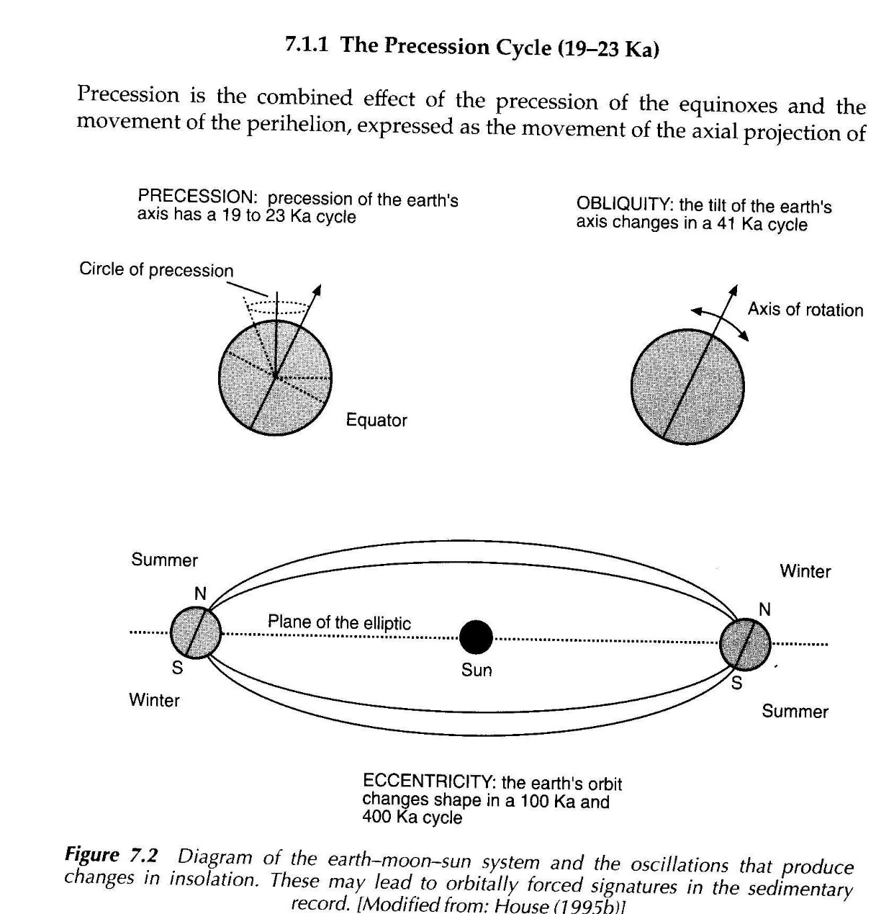

Slide 8
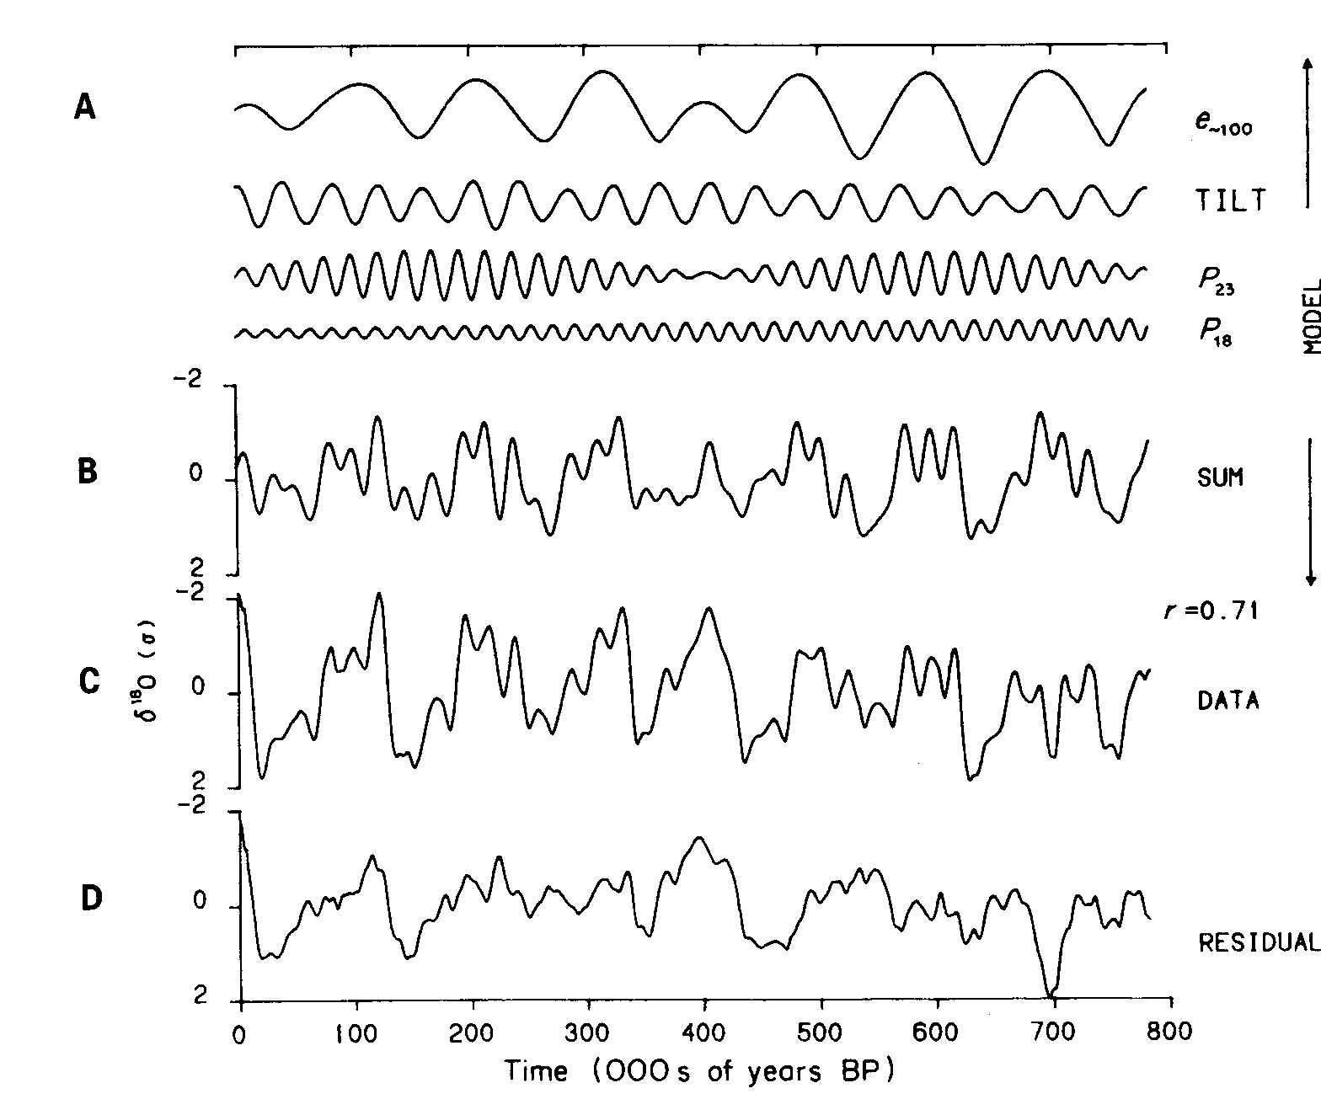

Slide 9
Temperature and Time
How do you obtain the curve
How do you calculate the temperature from the curve
How do you then date the peaks and troughs

Slide 10
Orbital Data to Temperature
Find a substance that records temperature
Use the marine oxygen isotope record
Oxygen is locked in calcite (shell material)
Collect a deep-sea core
Analysis of planktonic foraminifera shells
Dating using pollen in the case of the Eemian interglacial and magnetic reversals

Slide 11
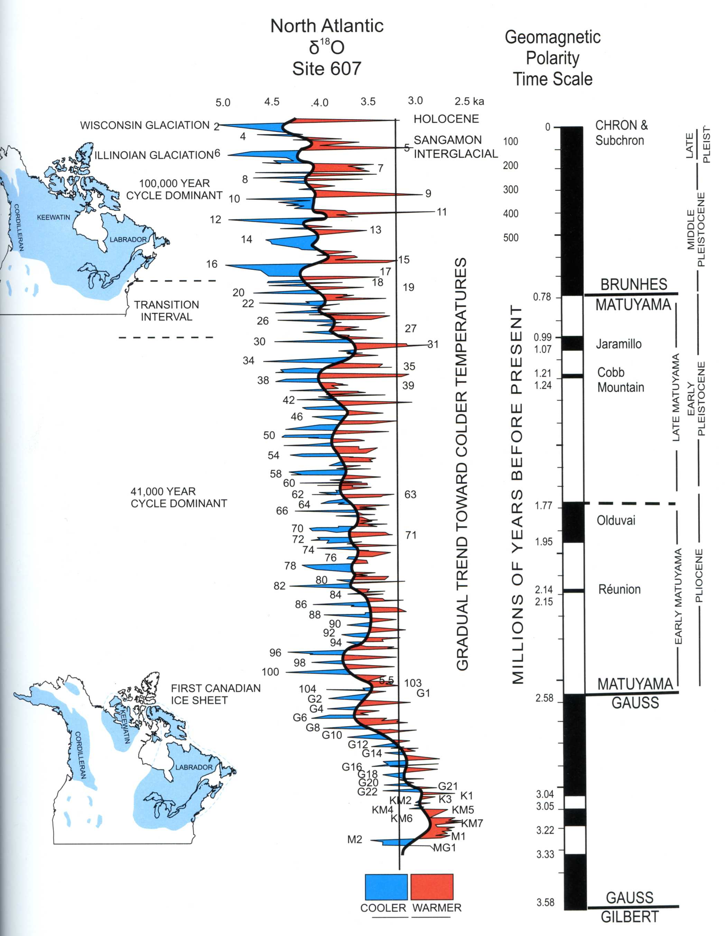

Slide 12
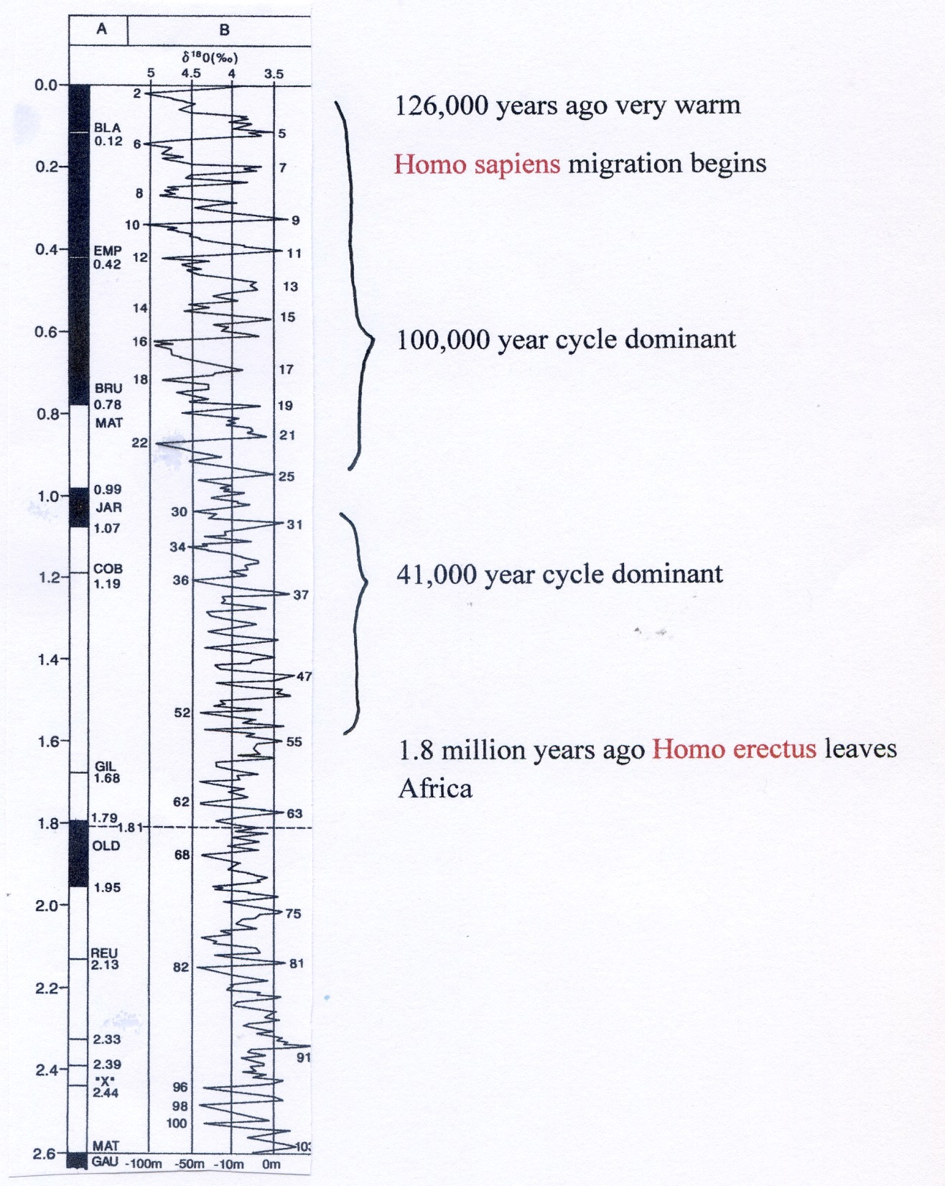

Slide 13
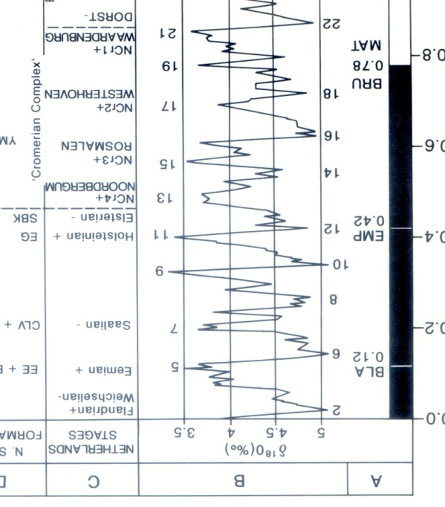

Slide 14
Hominid groups migrate
1.8m Hominid groups move out of Africa
900k Homo erectus in Norfolk
250k Neanderthals in Europe
100k Homo sapiens move out of Africa reach Levant too cold and retreat back into Africa
70k Toba volcano Homo sapiens almost lost
50k Homo sapiens returns to Levant
40 to 18k hunters, 10k start of cereal planting
Move from hunters to pastoral to farmers 8 to 6k
Start of petty kingdoms in the Levant based on water

Slide 15
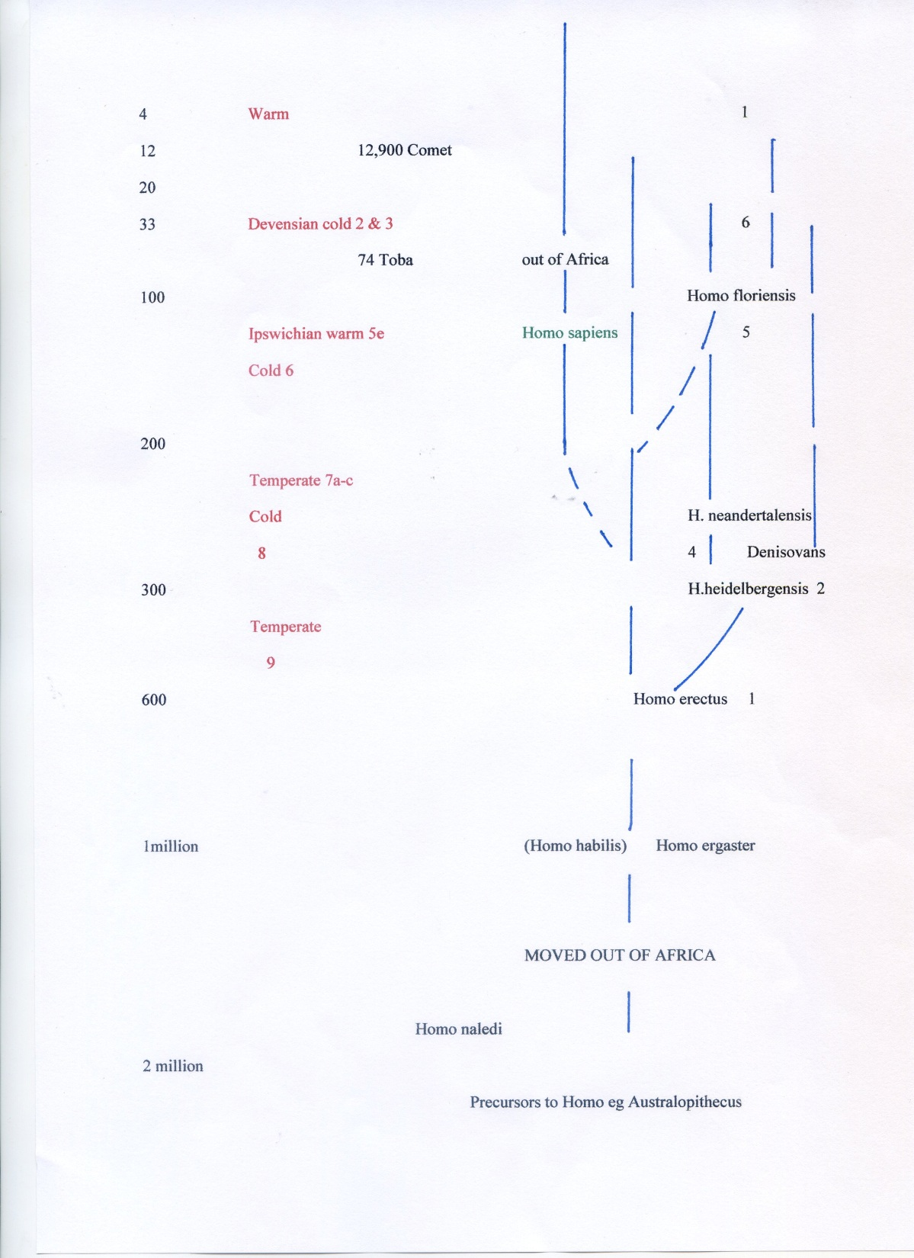

Slide 16
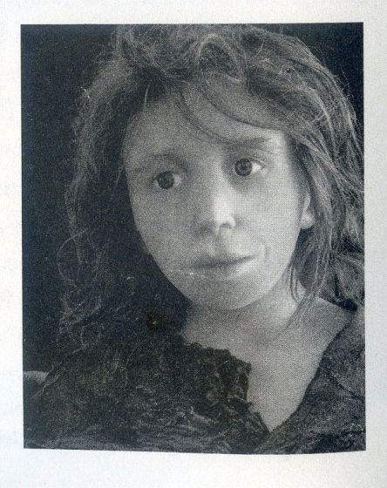

Slide 17
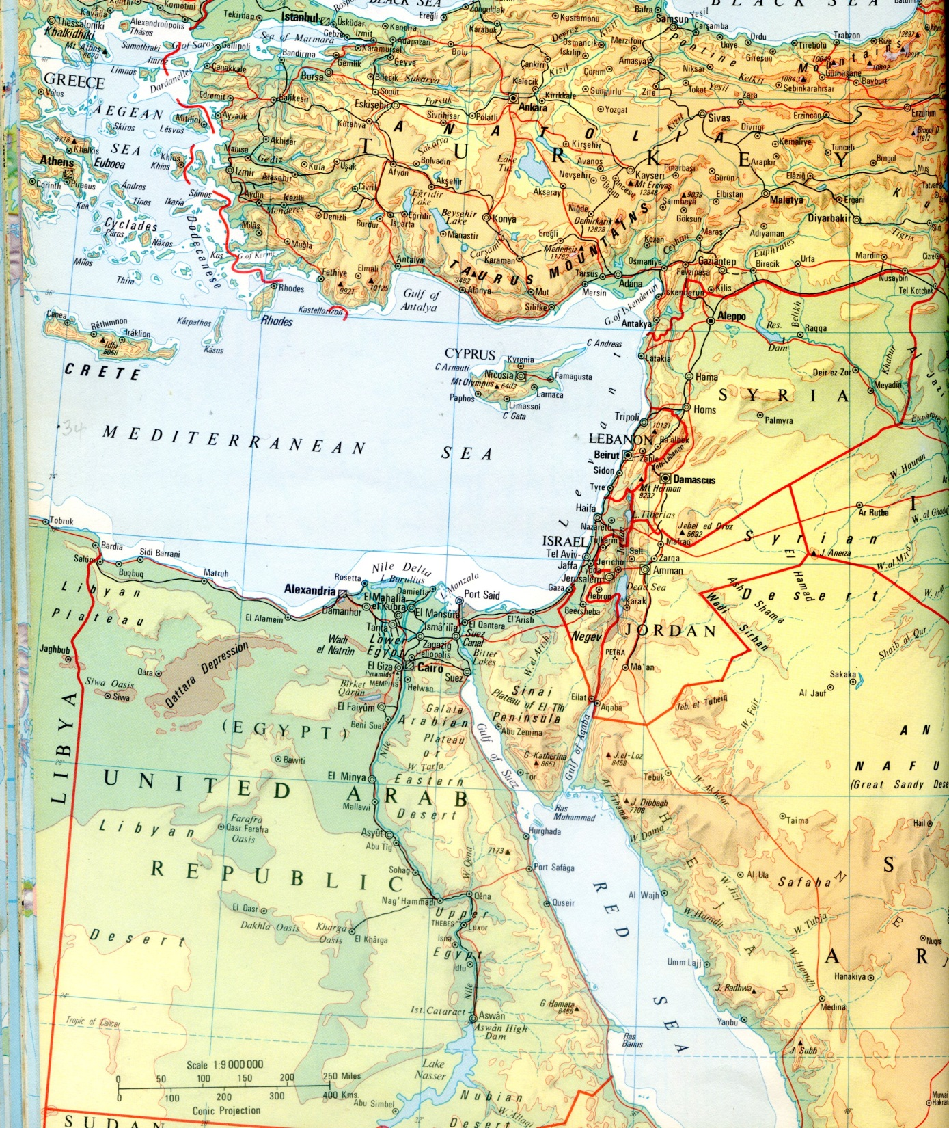
Map of the Levant

Slide 18
Evidence for climate change over the last 10,000 years
From the time of Ur to today
Neolithic revolution migration and farming
Stories from the Levant the lure of water
Nile, monsoon, Tigres-Euphraties snow melt
Jordan and its source problem
19th C and the volcano problem
Early 20th memories

Slide 19
Plankton
Plankton blooms CO2 absorption
Ultimate source of oil in rocks
Temperature and nutrients Cretaceous oil

Slide 20
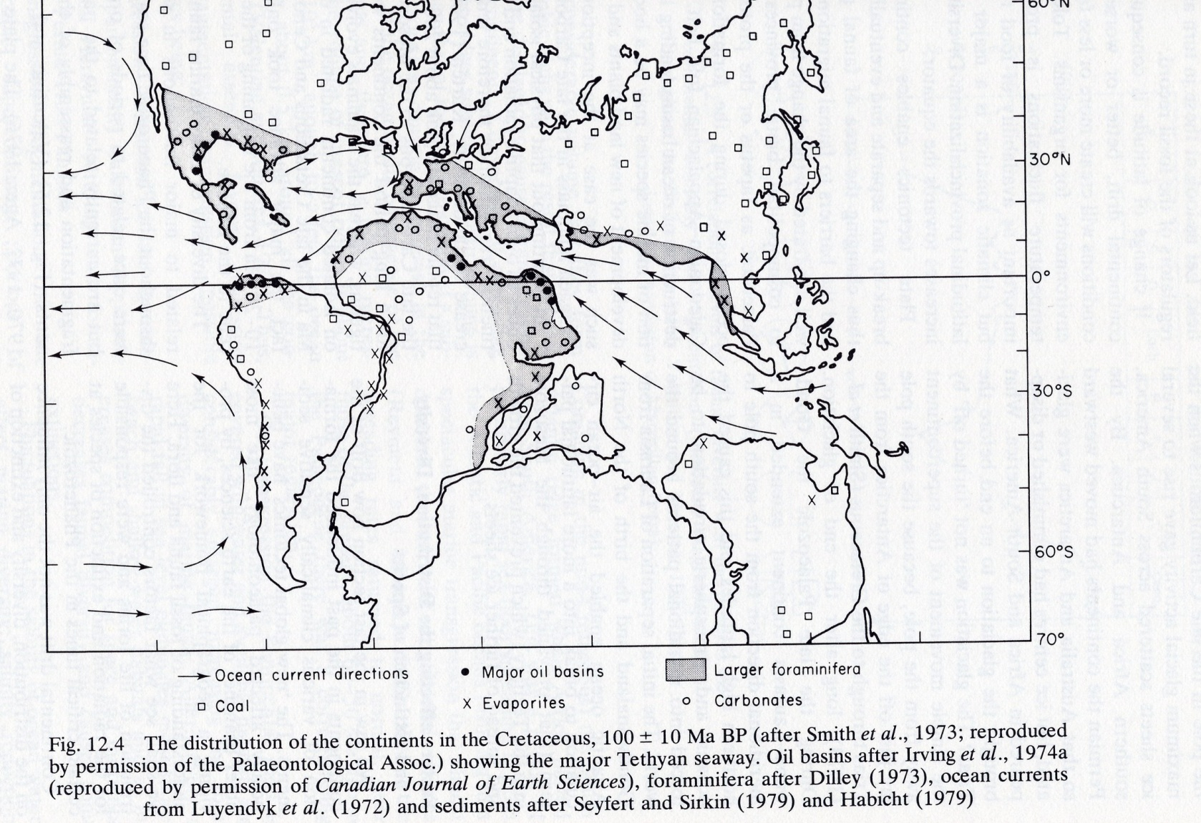

Slide 21
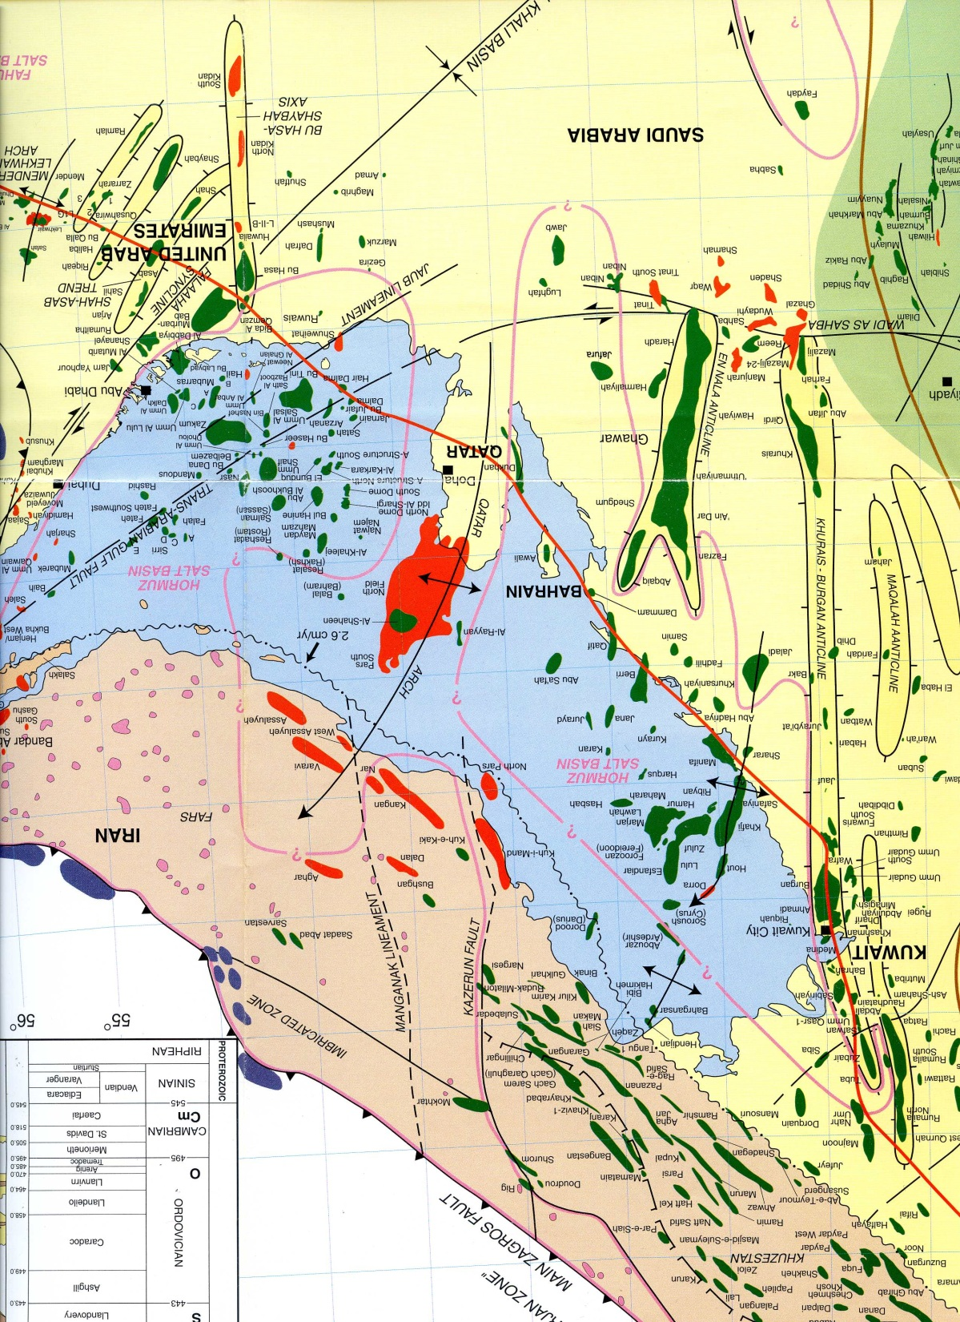

Slide 22
The last 14,000 years since the end of the last ice age in mid-Wales and Cardigan Bay
From bottom samples and seismic records collected in the Bay area
Geomorphology studies across mid-Wales
Human evidence from the area

Slide 23
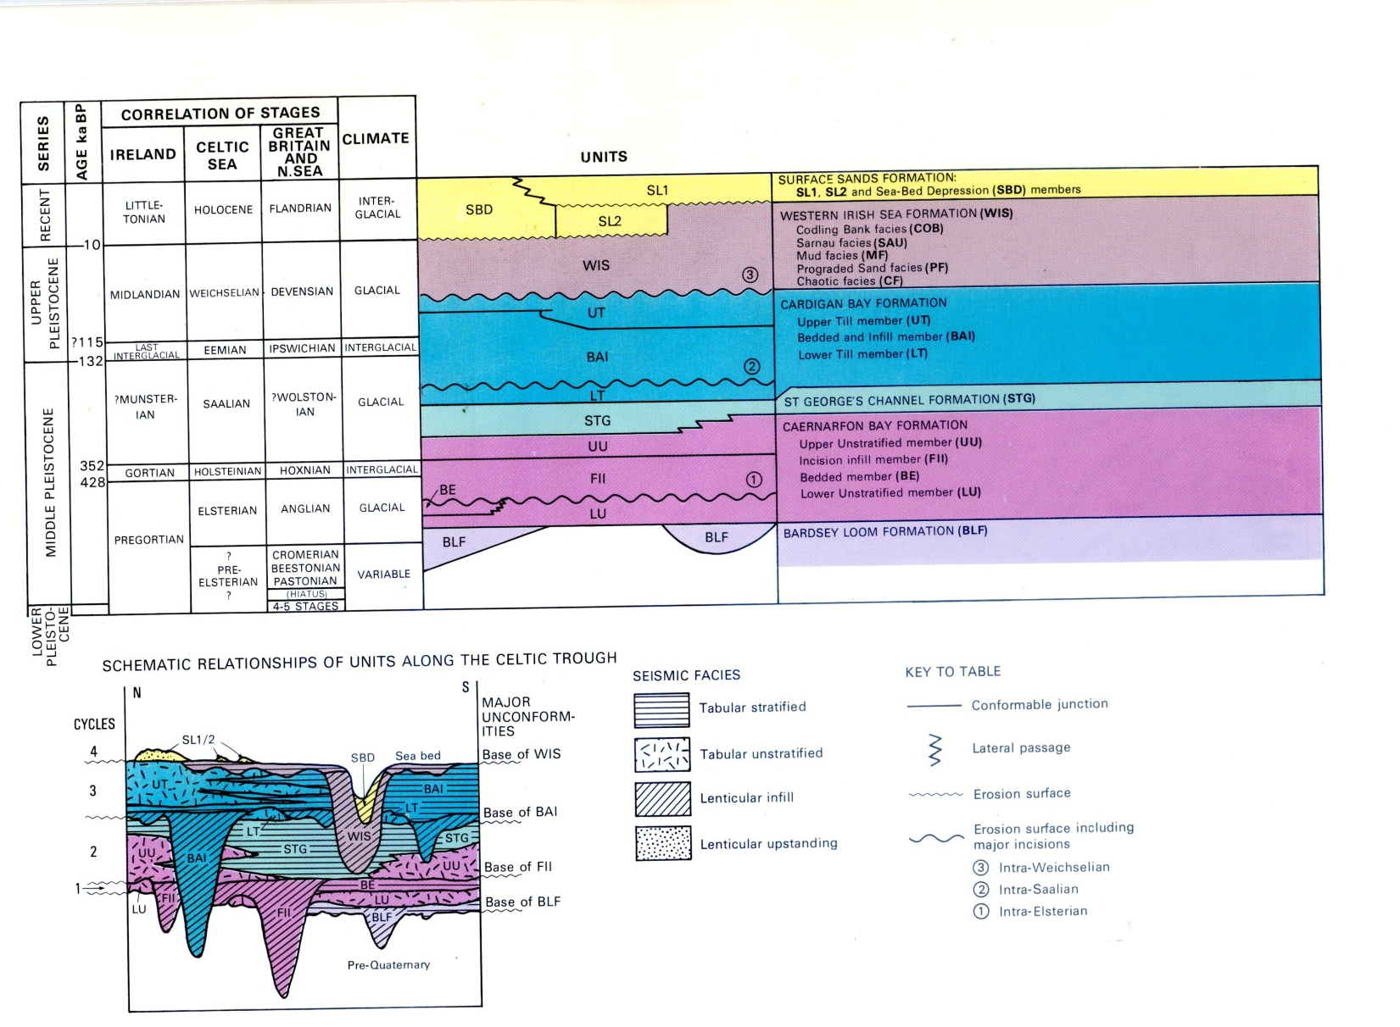

Slide 24
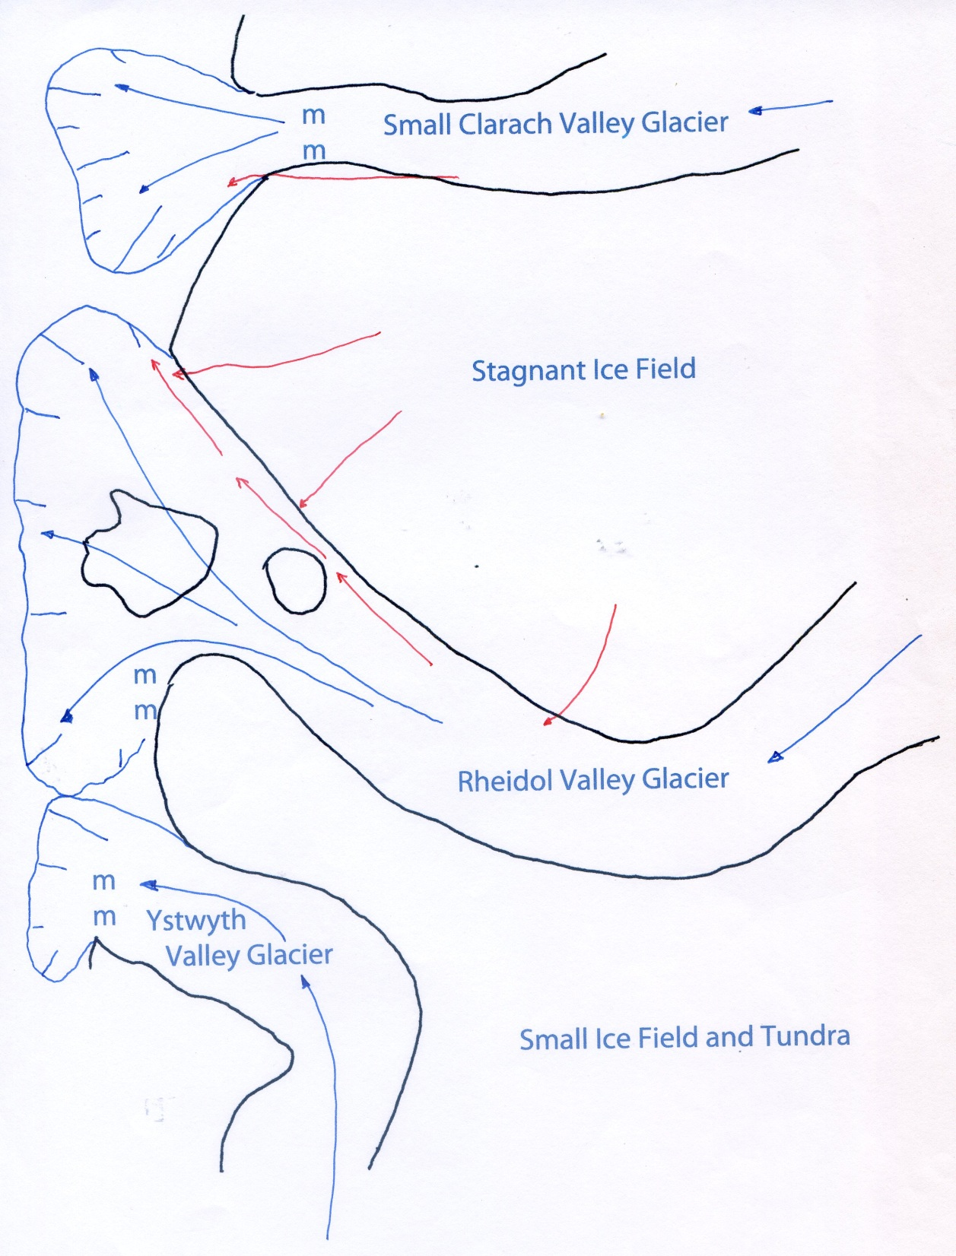

Slide 25
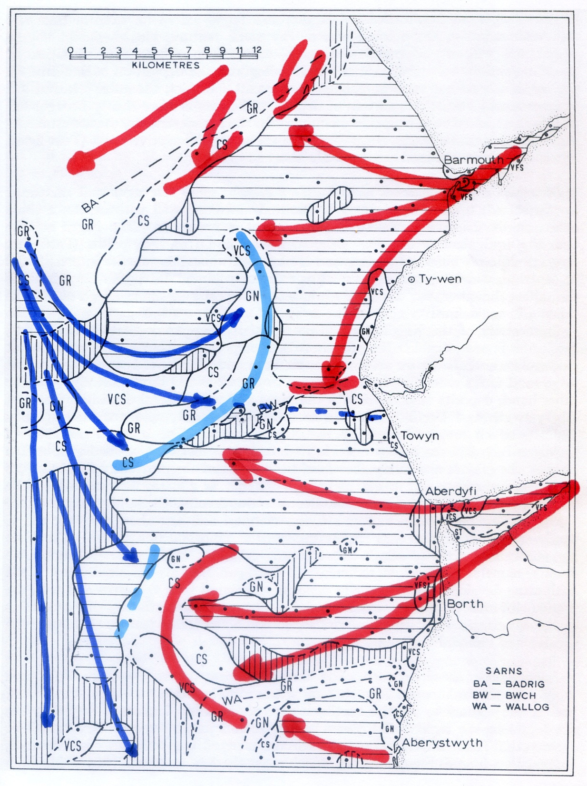

Slide 26
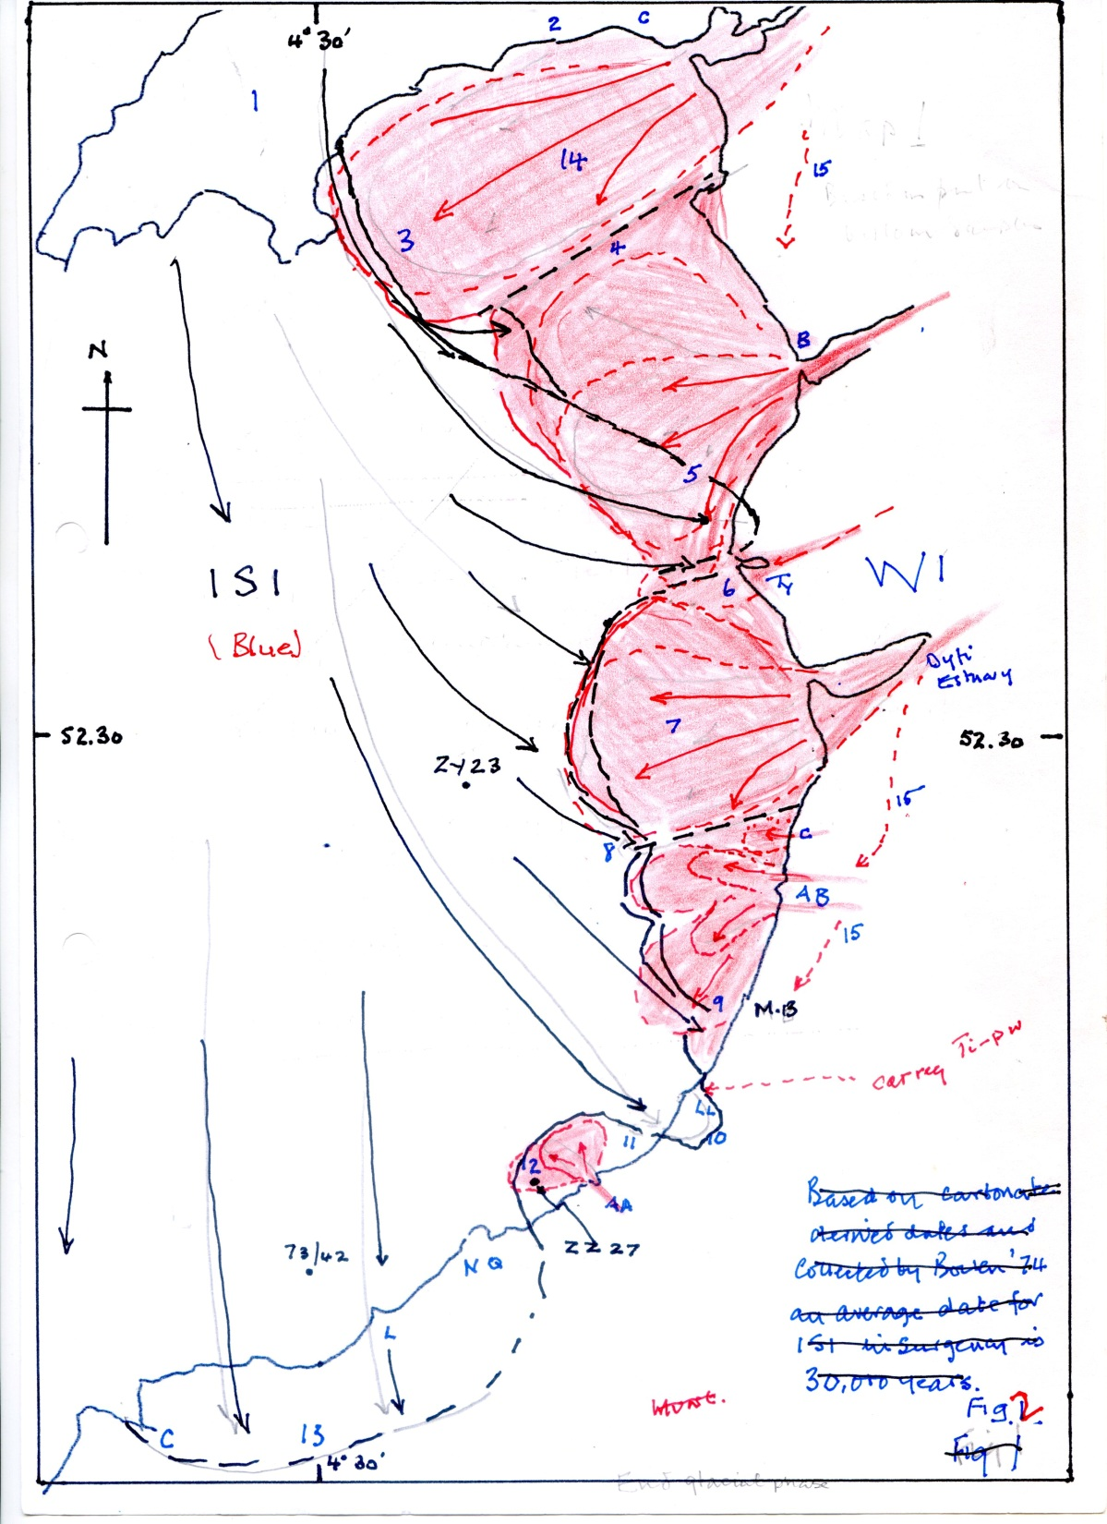

Slide 27
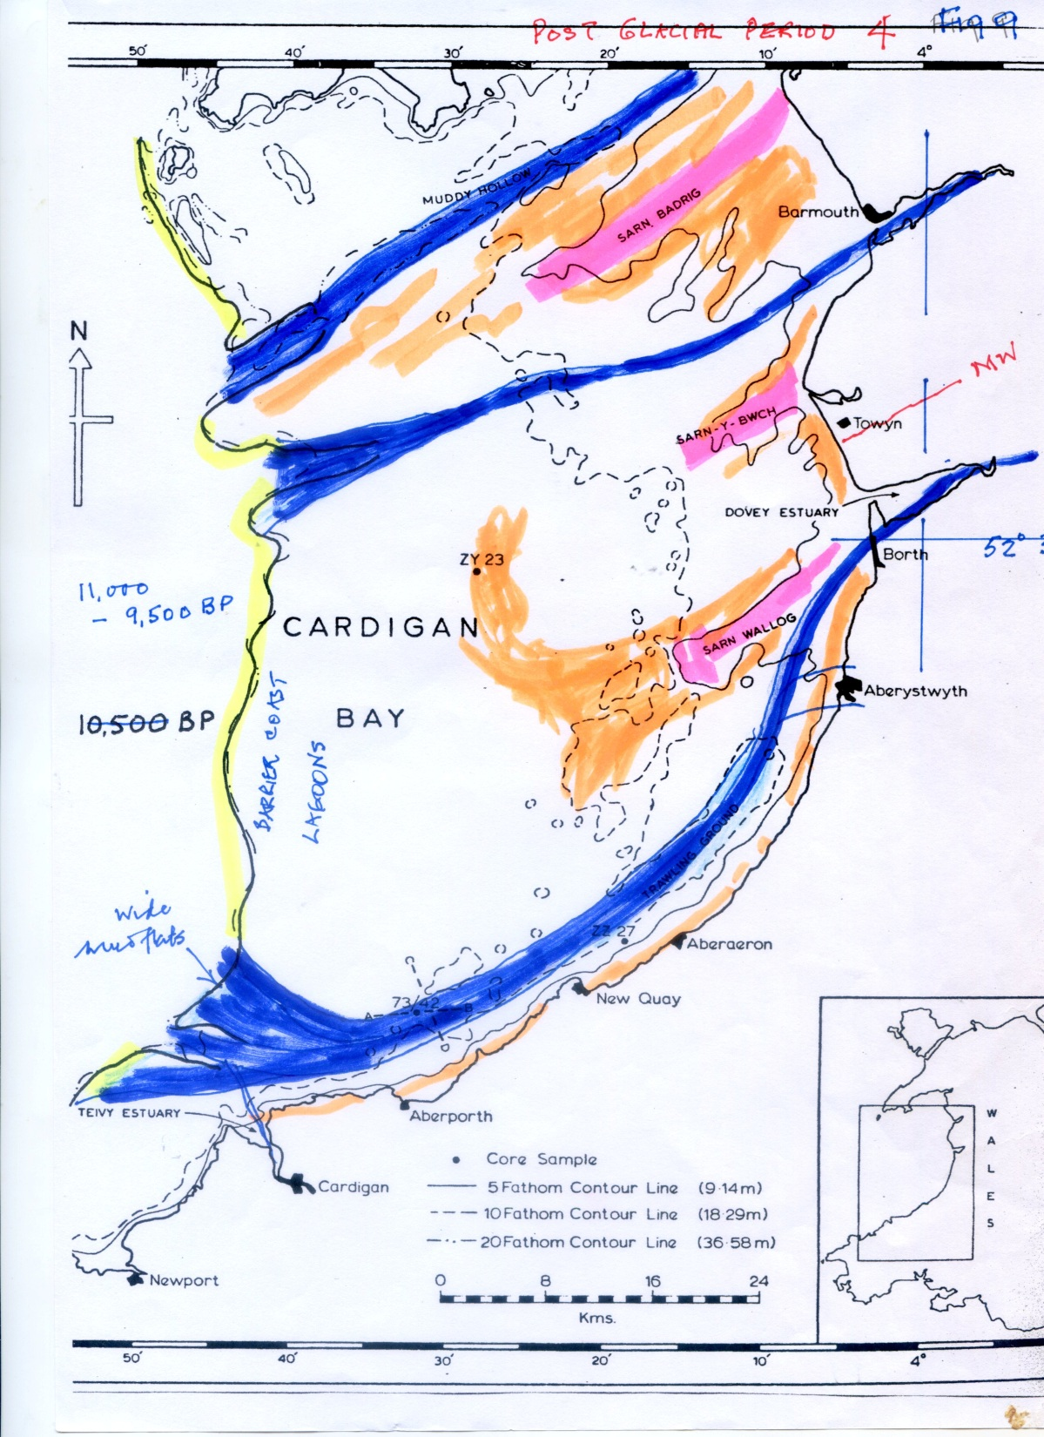

Slide 28
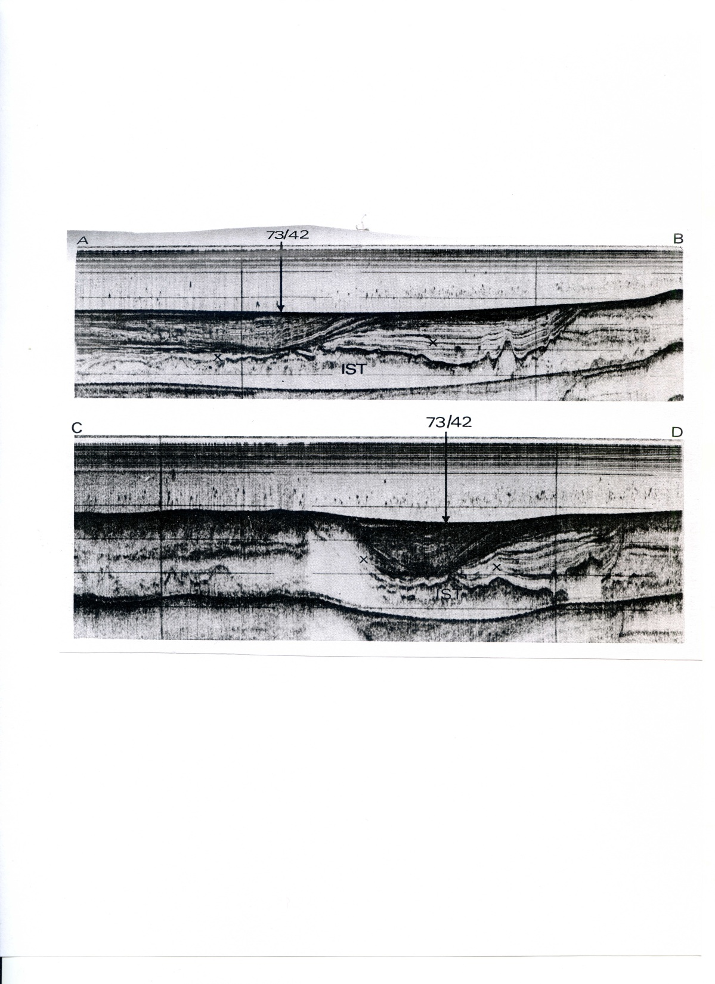

Slide 29
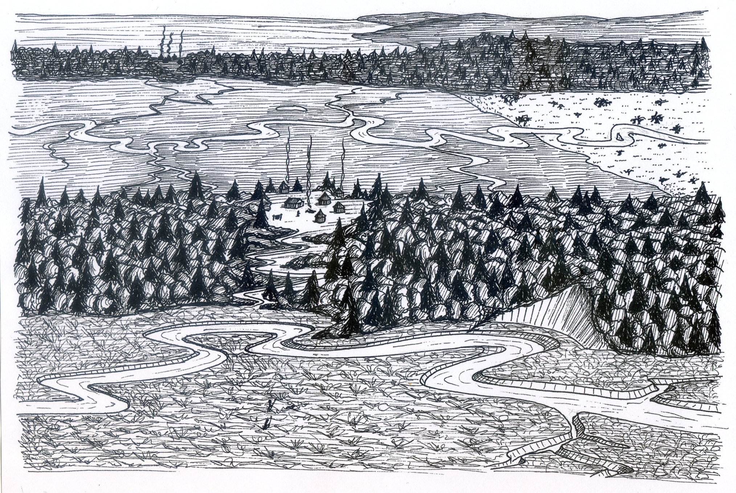

Slide 30
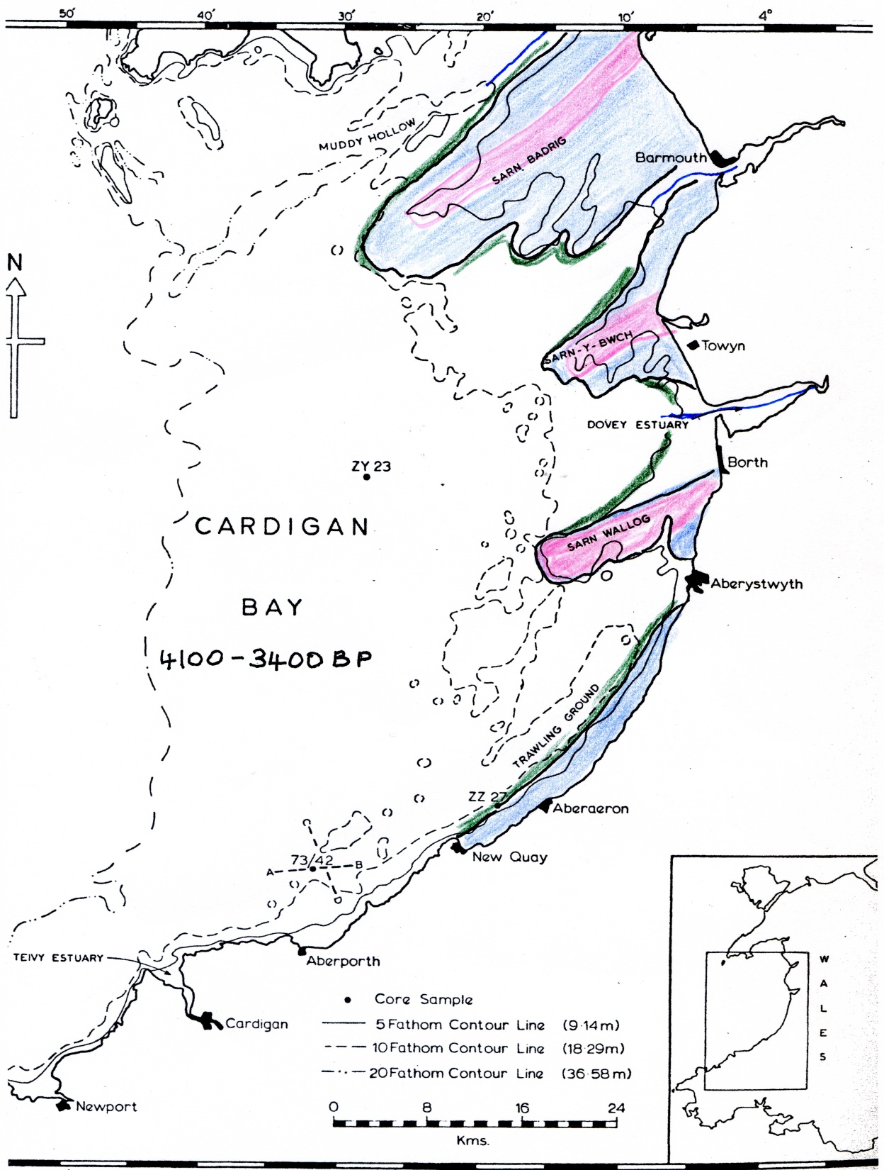

Slide 31
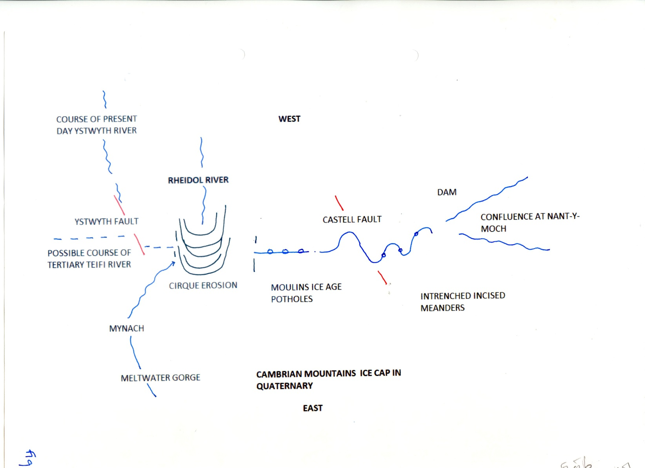

Slide 32
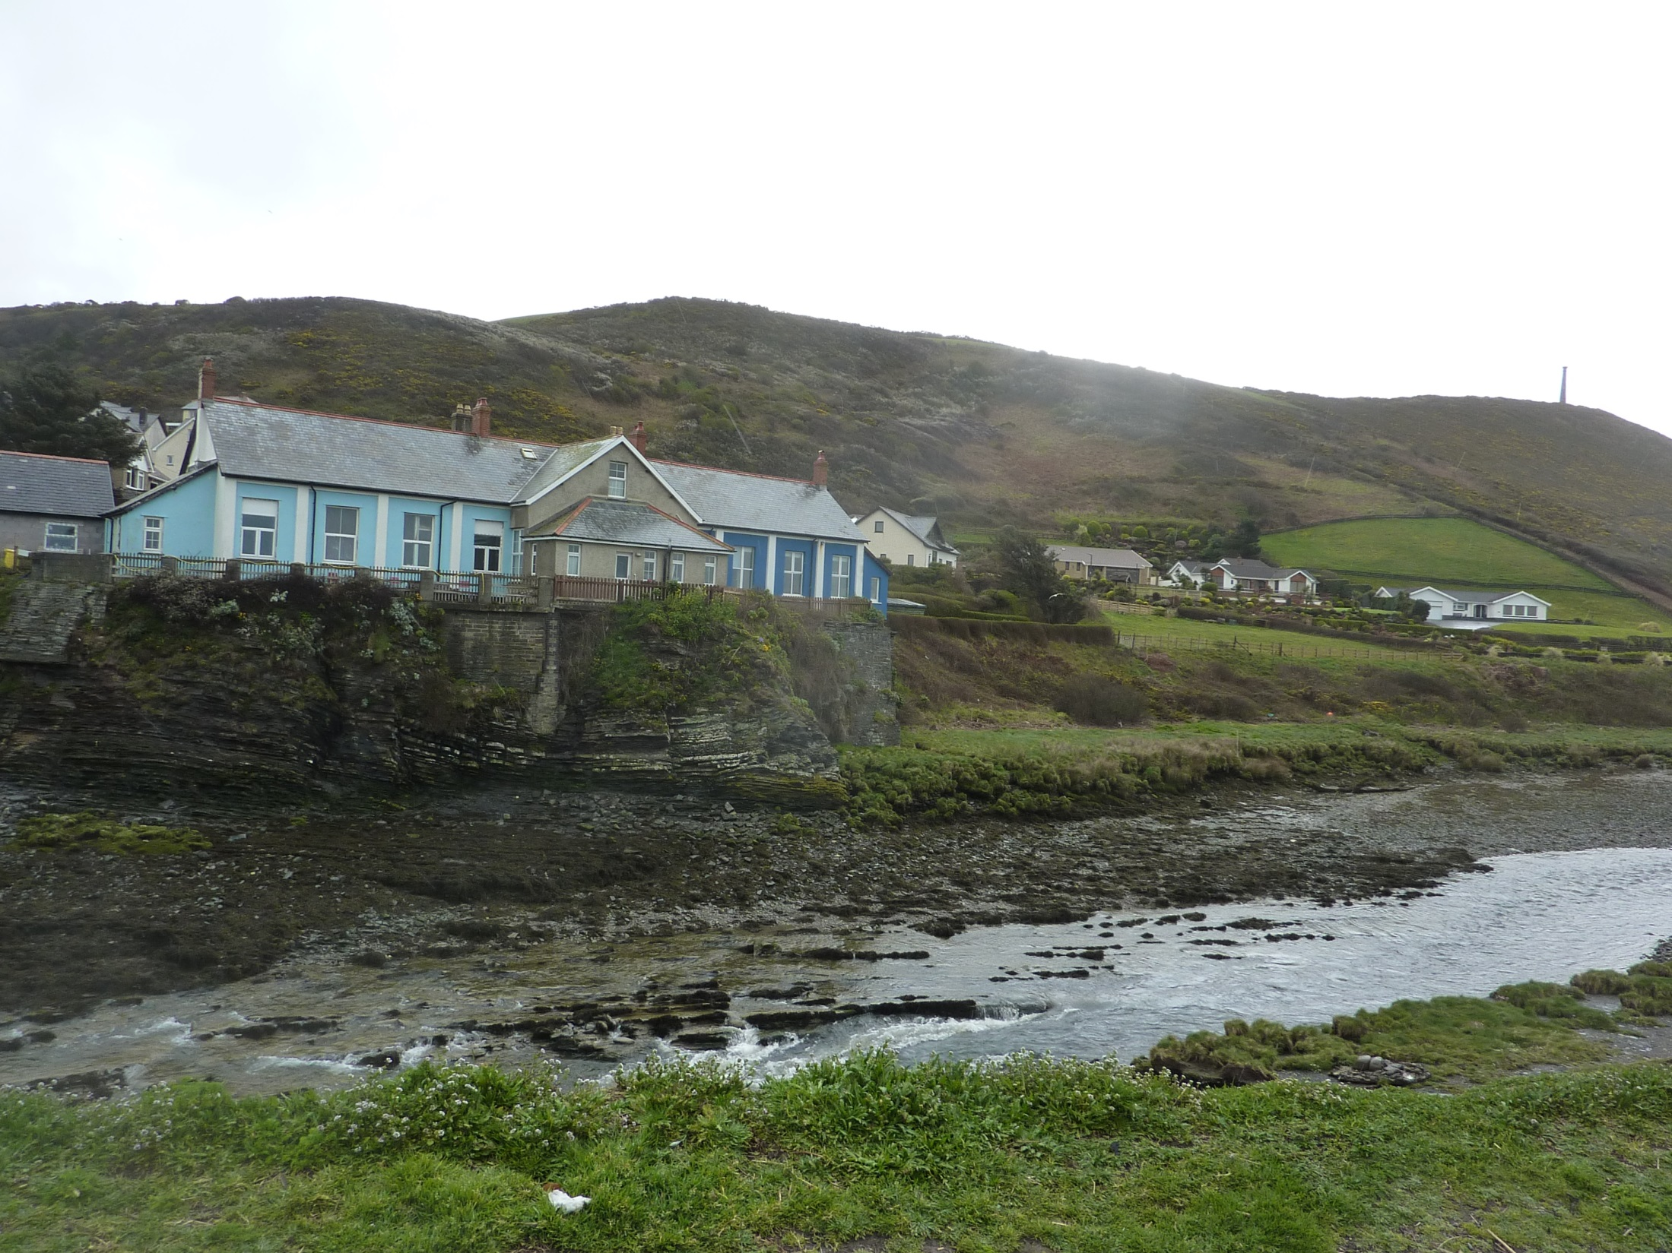

Slide 33
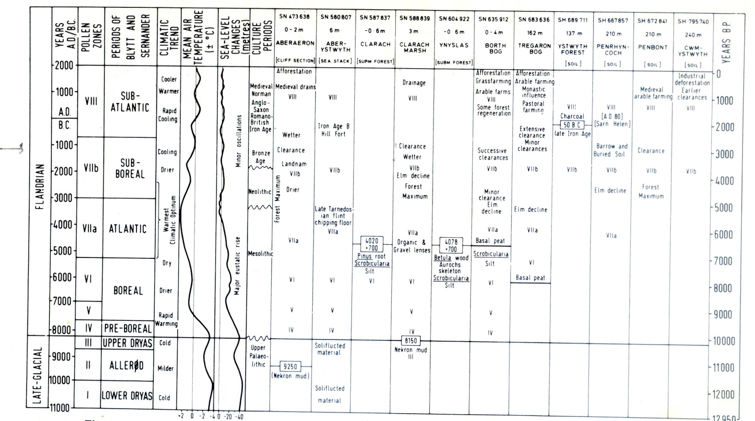

Slide 34
Climate and Man
Evolution of Homo species
Out of Africa and climate timings
Routes taken by different species
Opportunities offered by changing conditions
Migration and the development of agriculture

Slide 35
Volcanoes and Humans
Toba 74,000 years ago largest eruption for 28 million years, Climate affected for 10 years Homo sapiens reduced to less than 10,000 due to 11 billion tons of H2SO4 released which caused acidification & vegetation loss
Tambora 1815 weather affected for 3 years in Europe
Krakatau 1883 weather affected for 2 years

Slide 36
Fossil Fuels
Carbon Dioxide ppm in atmosphere from 200 to 420 ppm in 150 years
Plant absorption
Sea absorption and acidity
Takes 10-1000 years to burn
Takes 1 million years plus to form
Methane, clathrates and daffodils

Slide 37
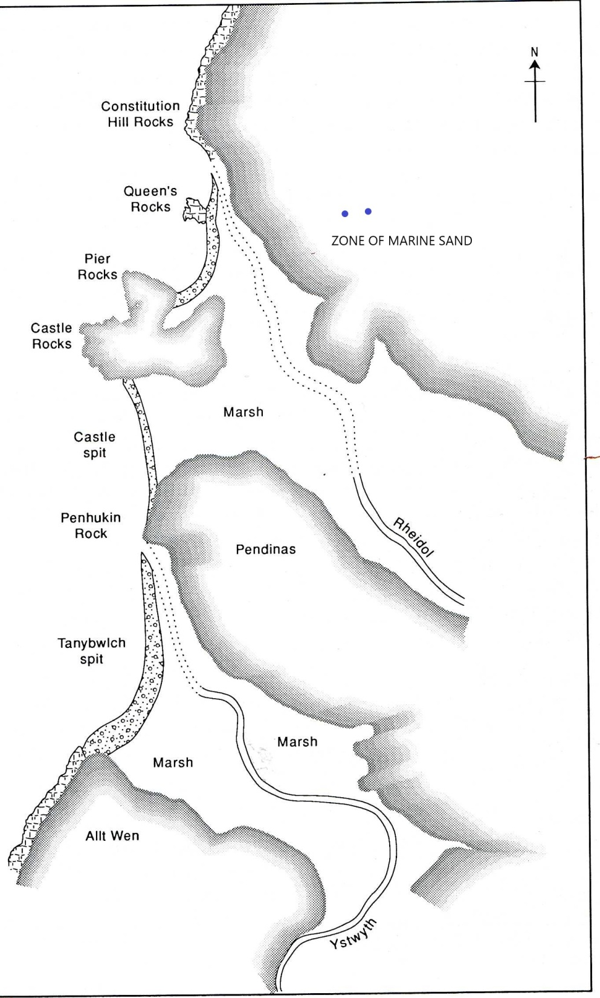

Slide 38
The Eemian
The most recent interglacial, also known as the Ipswichian and the Sangamon in the US
Occurred between 115 and 126,000 years ago
Temperatures were higher than today
Sea level was higher by about 6m

Slide 39
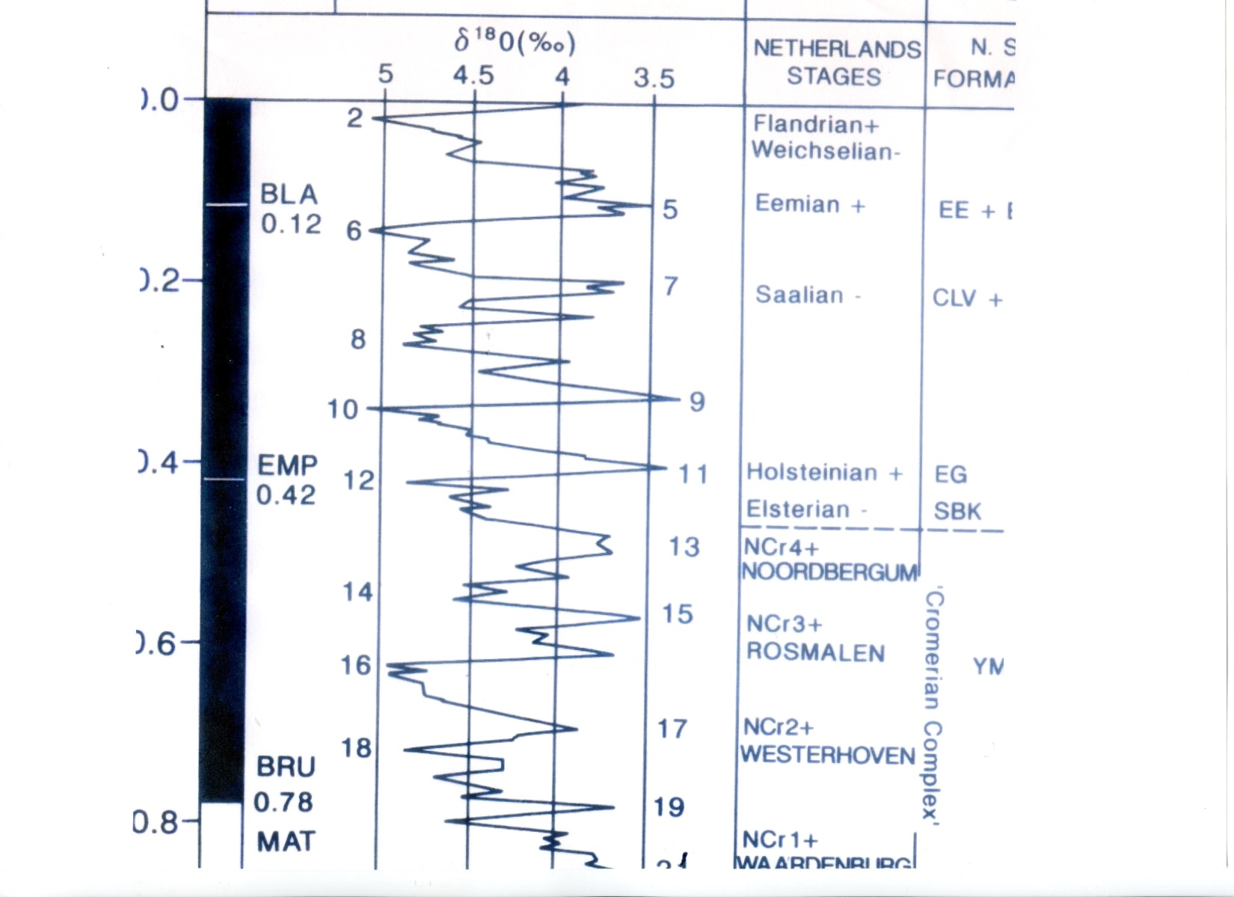

Slide 40
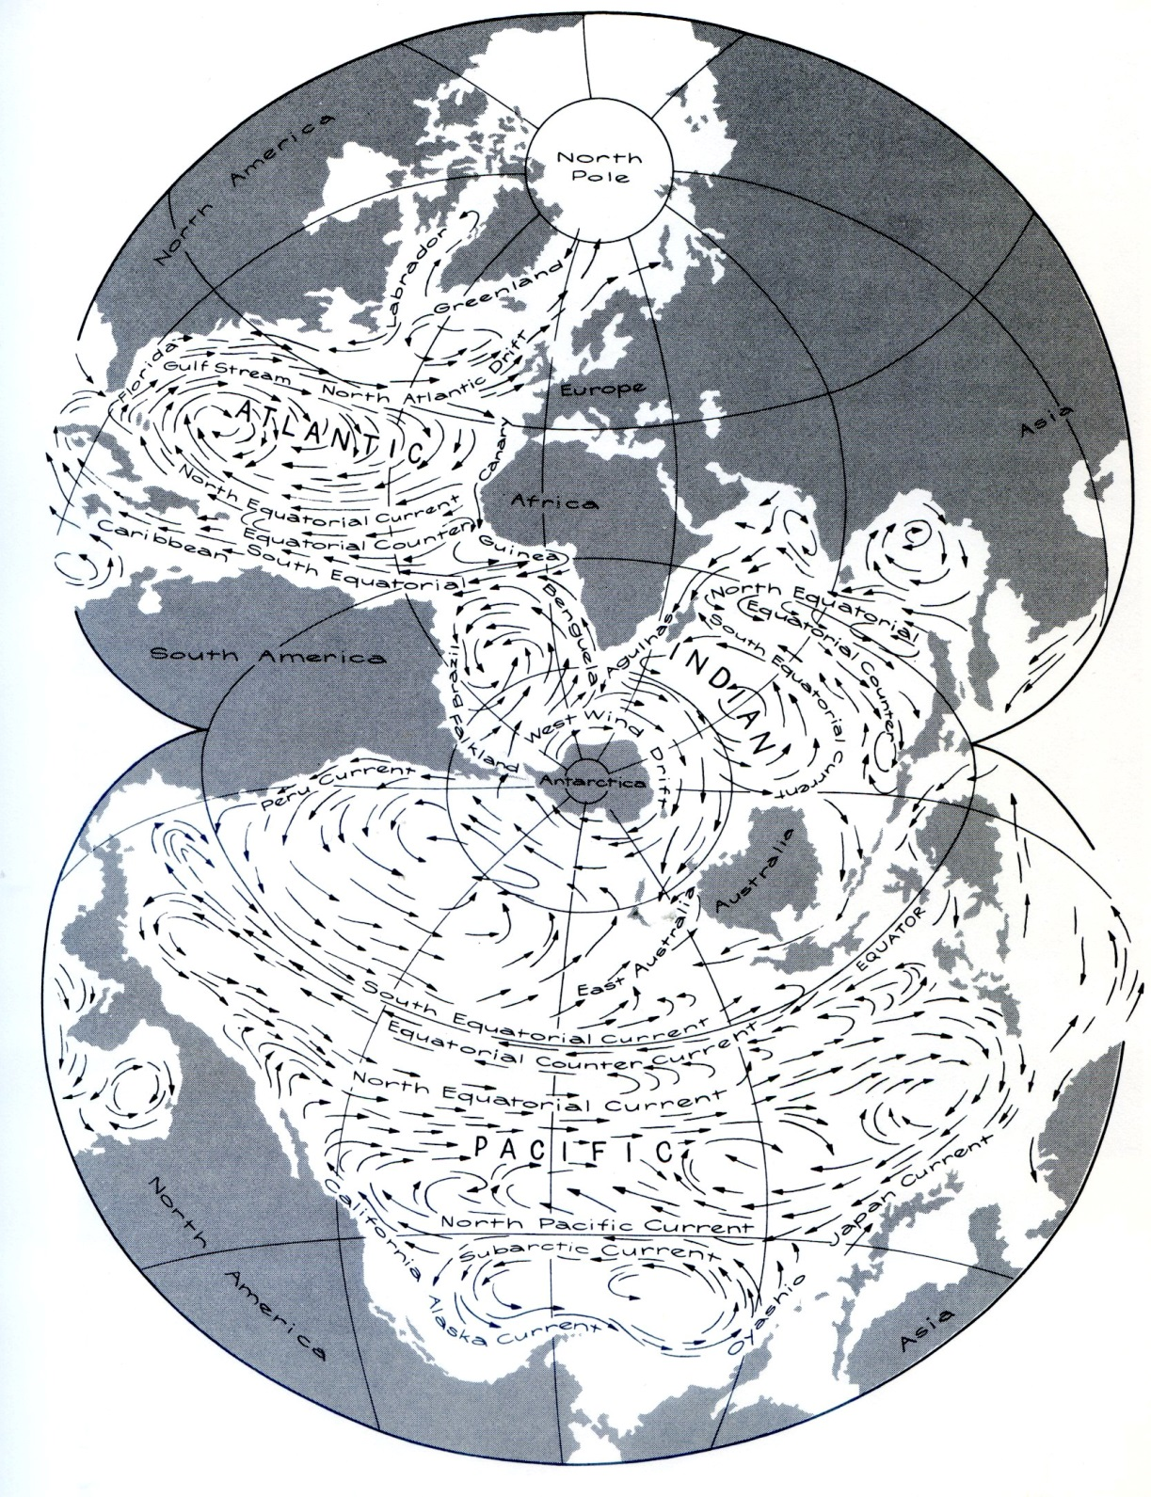

Slide 41
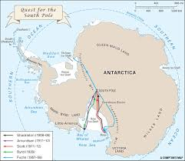

Slide 42
