Slide 1
Language in Prehistory: What Can and Can’t We Know?
Simon Rodway
Adran y Gymraeg ac Astudiaethau Celtaidd / Department of Welsh and Celtic Studies

Slide 2
The Earliest Linguistic Evidence for Britain
Julius Caesar, De Bello Gallico: visits to Britain in 55 and 54 BCE – records some place-names, ethnic names and personal names (SE Britain)
1c. BCE – coin legends from SE Britain (personal names)
Roman Britain – inscriptions, letters (Vindolanda), curse tablets (Bath, Uley), graffiti etc., almost all in Latin, but contain native place-, ethnic and personal names, and some Celtic words (not necessarily British)
Ptolemy’s Geography, c. 150 CE (place- and ethnic names).
At least two Celtic inscriptions from Bath

Slide 3
Earlier Evidence
1. Avienus (4c. CE) calls the Britons Albiones, perhaps drawing on a lost Greek source of 6c. BCE. Cf. Albion in Pliny, Bede etc. < *Albii̭u (> Old Welsh elbid ‘world’). What was the source? Celtic-speakers in Britain? Gauls?
2. Pytheas (4c. BCE) Prettania < *Pritani < *k^{w}ritu‑ ‘shape, form’ (cf. Welsh Prydain ‘Britain’)

Slide 4
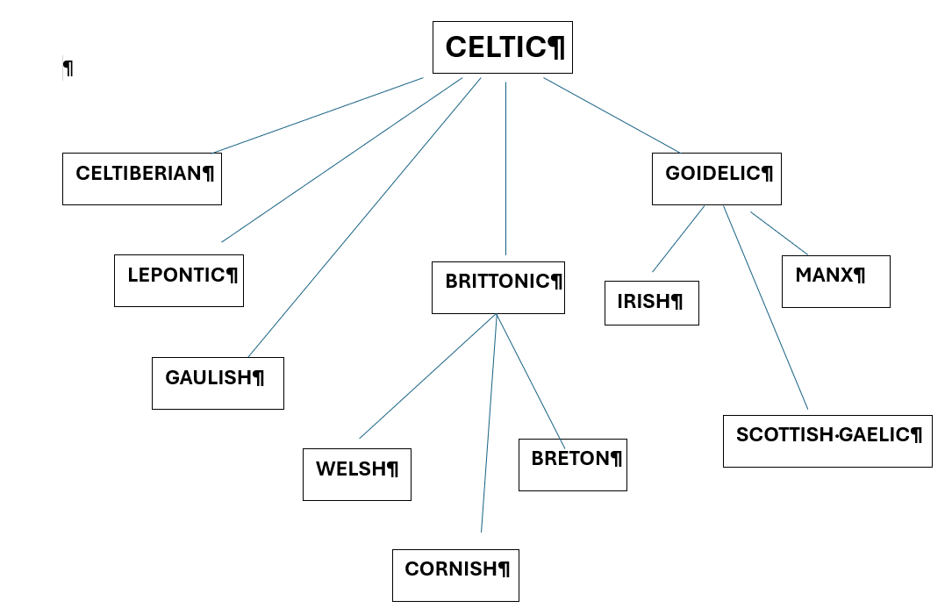
Celtic Languages

Slide 5
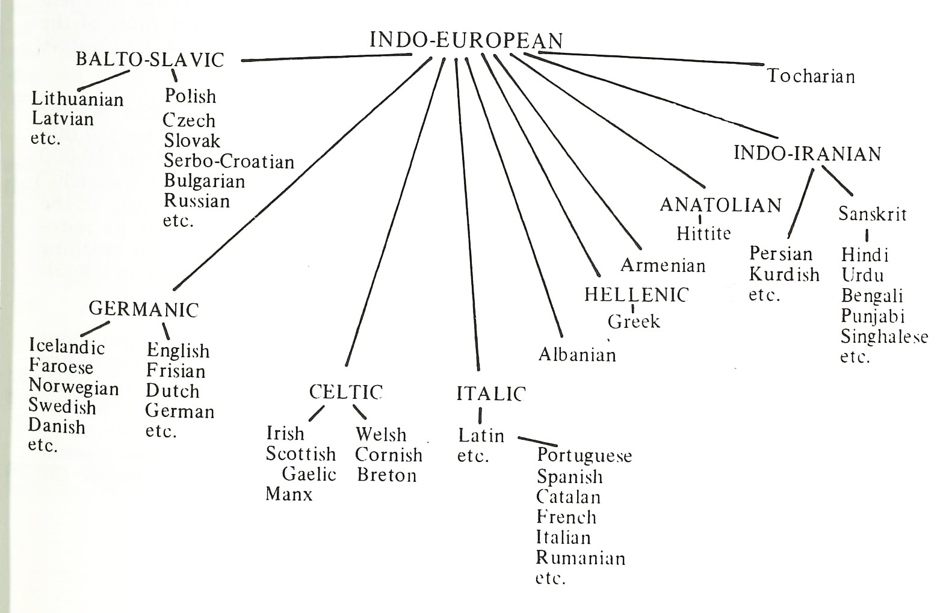
Indo-European Languages

Slide 6
Sound Laws
e.g. Grimm’s Law: Indo-European /p t k/ > Germanic /f θ h/, see Latin pater : Old English fæder : Gothic fadar; Latin tres : English three; Latin cornu : English horn.
NB Latin keeps the Indo-European sounds here [Indo-European */p/ was lost in Celtic, e.g. Irish athair ‘father’, but the others were retained at the beginning of a word, e.g. Welsh tri, corn].
Sound laws are normally ‘CONDITIONAL’, i.e. they depend on the position of the sound, e.g. in Latin pater : Old English fæder : Gothic fadar, we see Indo-European */t/ > Germanic */d/, not > */θ/ consistent with Grimm’s Law. Why?
The reason is this: in Indo-European the syllable before the */t/ was unaccented (*pHtēr), and in that position Indo-European */p t k/ became Germanic */b d g/ (Verner’s Law). Thus Grimm’s Law does not apply in every position.
Many sound changes are OCCASIONAL, depending in particular on ANALOGY, e.g. Old English fæder > Modern English father under the influence of brother, mother.
[Old English moÞer, broÞer – then the /θ/ is voiced to /ð/, Modern English brother [brəðə], mother [məðə]].

Slide 7
Reconstructing hypothetical languages
By working backwards from the attested languages, we can recreate hypothetical ancestor languages, such as Common Celtic, Common Germanic, Common Italic etc., and ultimately Proto-Indo-European.
We use asterisks to denote reconstructed sounds, words and sentences, thus IE *pHtēr ‘father’ etc.
The names (Celtic, Germanic, Indo-European) etc. are modern scholarly conventions: not all the languages which we call Celtic were called Celtic in the ancient period (e.g. British, Goidelic). Nonetheless we can prove that they are close relatives of the languages which the ancient authors did call Celtic (e.g. Gaulish), and that they derive independently from the same node on the Indo-European ‘family tree’.

Slide 8
Classifying languages
Shared innovations are important, not shared archaisms, thus the fact that Latin, Greek and Sanskrit have retained /p/ (pater, pater, pitar) does not necessarily mean that they are particularly closely related, but the fact that Gaulish and Irish have lost it (atir, athair) is potentially important and points towards their common descent from a hypothetical Celtic language.
But sound changes can occur independently. /p/ was lost in Armenian, so does that make Armenian Celtic?
NO, because other sounds behaved differently in the Celtic languages and in Armenian, e.g. /ṛ/ > Celtic /ri/ (e.g. Welsh rhyd ‘ford’ < IE *pṛtus) v. Armenian /ar/.

Slide 9
P and Q Celtic
In some Celtic languages a new /p/ developed from /k^{w}/ (Gaulish, British), but this did not happen in Goidelic or Celtiberian. In Goidelic, /k^{w}/ became /k/ before the Old Irish period (spelled c), thus:
Old Irish cenn : Middle Welsh penn; Ogham MAQ(Q)I (gen. sg.) > Old Irish macc (gen. sg. maicc) : Old Welsh map ‘son’.
But this sound change also occurs in, e.g., Romanian, Etruscan and some dialects of Greek, so it could have happened more than once in Celtic.
Morphological and syntactical evidence (e.g. VSO word order) suggest an ‘Insular Celtic’ ancestor for British and Goidelic.

Slide 10
What does the early evidence say about the language(s) of Britain?
Diagnostically ‘P-Celtic’ forms, e.g. Pritani if from *k^{w}ritu‑ ‘shape, form’; Epidii < *epos ‘horse’ < *ek^{w}os (cf. Old Irish ech, Latin equus)
Diagnostically Celtic forms (no k^{w} ~ p) e.g. Orcades ‘Orkney’ < *porkos (cf. Latin porcus ‘pig’) showing loss of /p/, cf. Old Irish orc ‘boar’; Mediolanum ‘Whitchurch’ with loss of /p/ (cf. Latin planus ‘plain’); Deva ‘the Dee’ < *deiwā ‘goddess’, showing Celtic /ei/ > /ē/.
Diagnostically IE forms (no specifically Celtic features), e.g. Mona ‘Anglesey’ < *men- ‘to rise’
Forms which lack a convincing IE etymology, e.g. Ebuda ‘Hebrides’

Slide 11
Glottochronology
If languages were to change at a set rate, then we could calculate approximately how long ago languages separated from one another, by totting up the amount of differences between them.
If we could calculate when ‘Insular Celtic’ separated from the other Celtic languages, that could give us an idea of when Celtic came to Britain.
Unfortunately, languages do not change at a regular rate: glottochronology, still practised by some linguists, is little better than pseudo-science.
Linguistics cannot take us back further than the earliest linguistic evidence.

Slide 12
Archaeology as a proxy for language?
Archaeological culture paradigm (Beaker Folk, Urnfield, Hallstatt, Golasecca, La Tène etc.)
Can archaeological cultures be equated with linguistic/ethnic groups?
In the 19th century, the Celts were equated with two central European Iron-Age cultures, and the spread of the Celts and their languages were linked to the spread of these cultures.

Slide 13
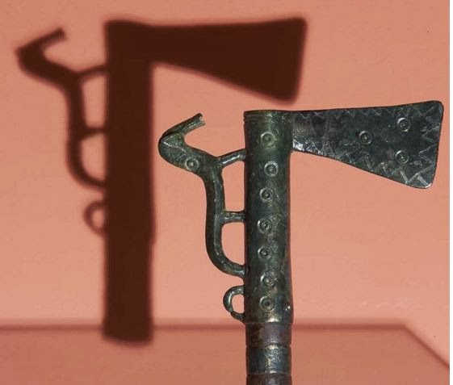
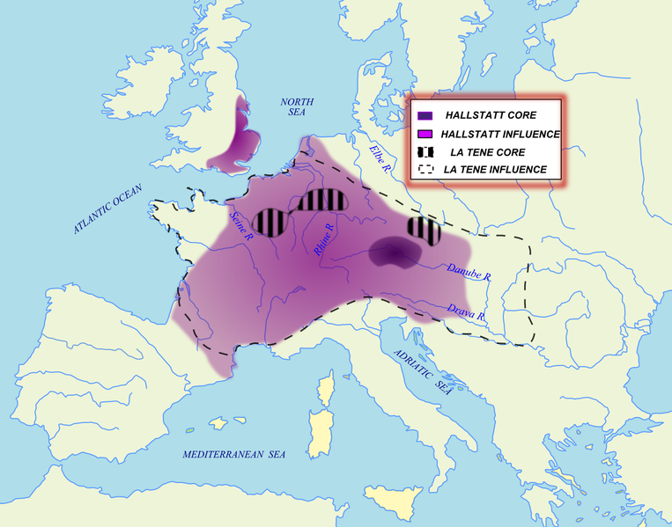
Hallstatt, c. 700 – 500 BCE

Slide 14
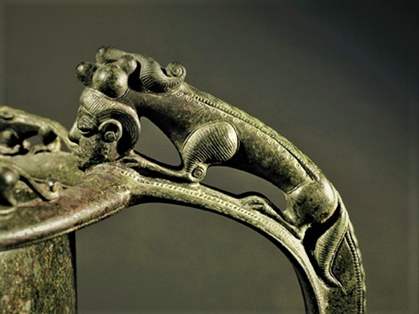
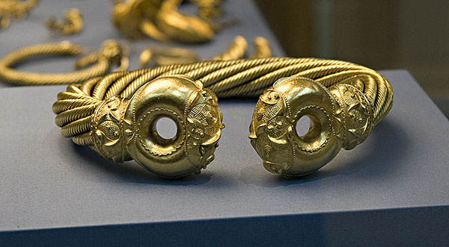
La Tène (c. 500 BCE onwards)

Slide 15
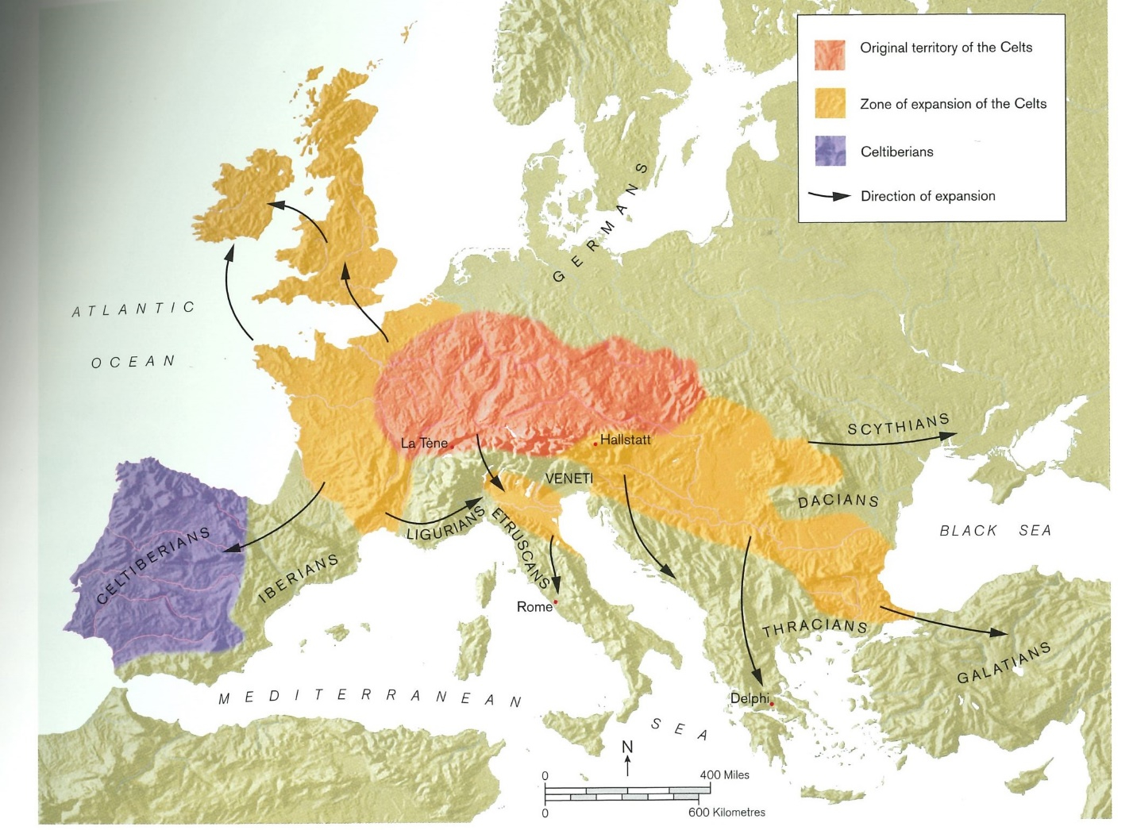
The traditional view of ‘the expansion of the Celts’

Slide 16
Problems
The expansion of La Tène does not completely correspond to areas of Celtic speech (e.g. much of Ireland, the Iberian Peninsula, Galatia)
We have inscriptions in a Celtic language (‘Lepontic’) from N. Italy from the 7c. BCE onwards, about 250 years before La Tène arrived there, in the context of the very different Golasecca culture.
Some famous La Tène objects, e.g. the Gundestrup Cauldron, may have been made by non-Celtic-speakers (perhaps Thracians in this case).
The original connection of Hallstatt and La Tène with Celts is based on dubious evidence, a suggestion that Nyrax, a city said by Herodotus to be close to the land of the Celts, was implausibly identified by early modern scholars with Noricum (Austria).

Slide 17
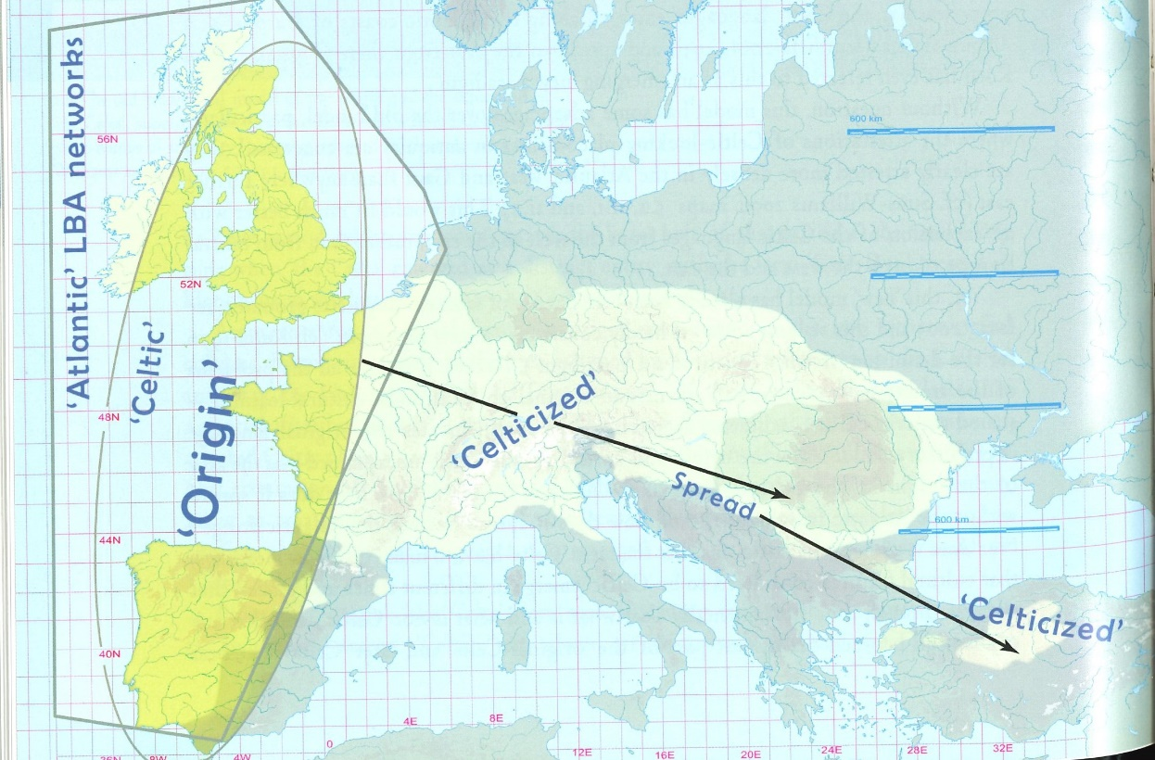
Celts from the West?
This theory posits that Celtic languages developed in Late Bronze Age [LBA] Spain and Portugal and spread along the Atlantic trade routes to Gaul, Britain and Ireland, and thence inland into central Europe.
This was first proposed in 1987 by Colin Renfrew, and is now favoured by Barry Cunliffe & John Koch
As there is no linguistic evidence for Celtic from the Bronze Age, then this theory once again uses proxies: archaeological & genetic.

Slide 18
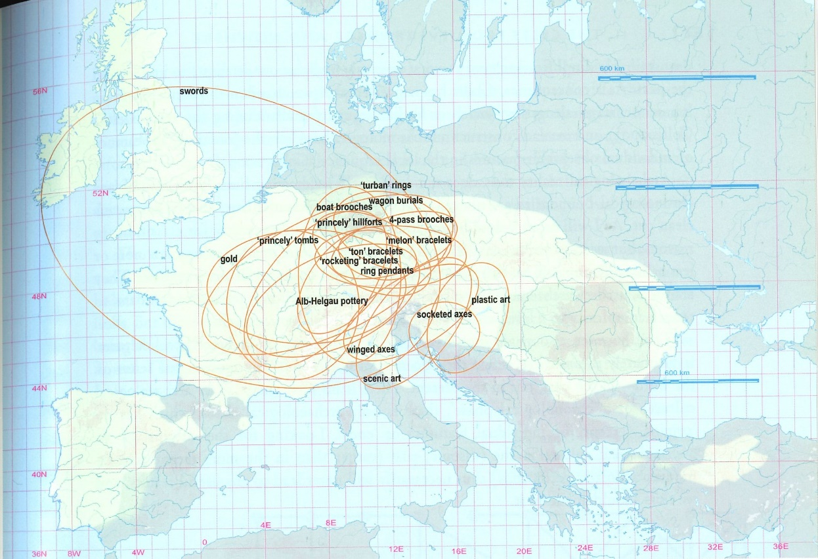
Questions
Can archaeological cultures be equated with peoples?
How valid is the concept of an archaeological culture?
The map (by Raimund Karl) shows the messy reality that lies behind neat maps of ‘Hallstatt culture’

Slide 19
Modern population genetics and ethnic groups in Antiquity
Since the 1970s some geneticists have tried to combine genetic data from modern populations with archaeological/linguistic data to map the movements of ethnic/linguistic groups in prehistory.
Exact dates cannot be offered for mutations in, for instance, the Y chromosome (male line) or in mitochondrial DNA (the female line).
Ellen Røyrvik: ‘the standard errors of dating genetic splits is often so large as to be useless in respect of human history’
Thus it is risky to connect variation in the genetic makeup of modern European populations with prehistoric movements.

Slide 20
Ancient DNA
In the case of DNA from archaeological sites, dating problems do not arise, because a date can be proposed on the basis of archaeological evidence
More and more ancient DNA is being collected, and surprising claims have been made on this basis, but it is a fast-moving field.
In 2018, the results of a study of over 400 ancient skeletons from different parts of Europe, including 155 from Britain who lived between 6000 and 3000 years ago. It was announced that there was a substantial change in the population of Britain about 4500 years ago (about 90%), and that this coincided with the arrival of the ‘(Bell) Beaker Folk’. John Koch speculated that this might have been the event which brought Celtic to Britain.
In 2021 the results of another study which showed that there was an influx of people into Britain during the late Bronze Age (contradicting the previous study) from what is now France. There was evidence that there was not much movement after that. The authors of the study suggested that it could have been these people who brought a Celtic language to Britain, and this hypothesis has received cautious support from Patrick Sims-Williams.

Slide 21
The Invasion Hypothesis
The idea that cultural/linguistic changes occurred because of invasions, with a new group killing or driving out the previous inhabitants – the British aborigines are conquered by the Celts, who are then defeated by the Romans, who yield to the Anglo-Saxons, who suffered at the hands of the Vikings, and finally the Normans arrived.
Cf. the Victorian context, with the British Empire seizing the lands of native peoples all over the globe.
This paradigm was challenged by Graham Clark, ‘The Invasion Hypothesis in British Archaeology’, Antiquity, 40 (1966), 172-89

Slide 22
‘Cumulative Celticity’)
C. F. C. Hawkes, ‘“Cumulative Celticity” in Pre-Roman Britain’, Études celtiques, 13 (1973), 607-28
Small high-status groups can have a large effect on culture/language without leaving much of a genetic mark (cf. ‘cumulative Anglicization’ in Wales, Ireland etc today).
The best that ancient DNA evidence can provide evidence for an event by which a language might have arrived in Britain.

Slide 23
Other prehistoric languages in Britain
There may have been many.
Some scholars have detected ‘substrate’ features in the attested languages of Britain.
Comparison of Welsh and Irish with Afro-Asiatic languages, including Berber, Hebrew and ancient Egyptian reveals syntactical similarities (e.g. VSO word order), but these can all be explained without recourse to substrate theory.
Recently, an idea has had quite a bit of publicity that a Germanic language was spoken in eastern Britain before the Roman Conquest: there is no remotely plausible linguistic evidence for this.

Slide 24
Conclusion
A Celtic language, ancestor to Welsh, Cornish and Breton, was spoken in much of Britain before the Roman Conquest.
It is impossible to say for certain when, how and from where it arrived: almost certainly by 4c. BCE, and quite possibly coinciding with the population change visible in the genetic record at the beginning of the Iron Age.
We can say nothing definite about other prehistoric languages in Britain: there may have been many, both Indo-European and non-Indo-European.
This subject has intrinsic interest, but we must guard against drawing comparisons with modern issues around ethnic and linguistic identity, movement of people etc.

