Slide 1

Since 2019, the Older People’s Commissioner (OPC) has been working with and supporting local authorities to develop as age friendly communities and to apply for membership of the WHO Global Network of Age Friendly Cities and Communities.
For Ceredigion this work began in the Autumn of 2022.

Slide 2

What is an Age-Friendly Community?
In an age-friendly community we feel valued, included, respected and can:
Get out and about
Do things that we want to do
Lead healthy and active lives
Access information
Make our voices heard

Slide 3

The World Health Organisation (WHO) describes age-friendly communities as being places in which older people, communities, policies, services, settings and structures work together in partnership to support and enable us all to age well.
They identify eight essential features of age-friendly communities, known as the ‘eight domains’.
Outdoor Spaces & Buildings
Transport
Housing
Social Participation
Respect & Social Isolation
Civic Participation & Employment
Communication & Information
Community Support & Health Services

Slide 4
The story so far
Autumn 2022 an Ageing Well Officer was appointed.
October 2022 in conjunction with Centre for Ageing and Dementia Research we began engagement sessions at local supermarkets and with local groups to ask 3 questions -
- What’s good about growing older in Ceredigion?
- What’s not so good about growing older in Ceredigion?
- What could be better about growing older in Ceredigion?

Slide 5
“More information should be sent out to older people similar to the cost-of-living leaflet which was very informative.”
“I had to visit the Minor Injuries Department here. A fantastic experience. Everybody, from reception to the medical staff were excellent. Nothing was too much trouble.”
“Streets around Cardigan are good for mobility scooters.”
“I love where I live. We moved here because it was a family home and by the sea. I’m a cold sea swimmer and I’m looking forward to getting back out there, people are friendly.”
“Parking is difficult in towns.”
“Increase public toilets – women, men, neutral.”
The feedback from those engagements was then categorized against the 8 domains and formed the baseline of our self-assessment.

Slide 6
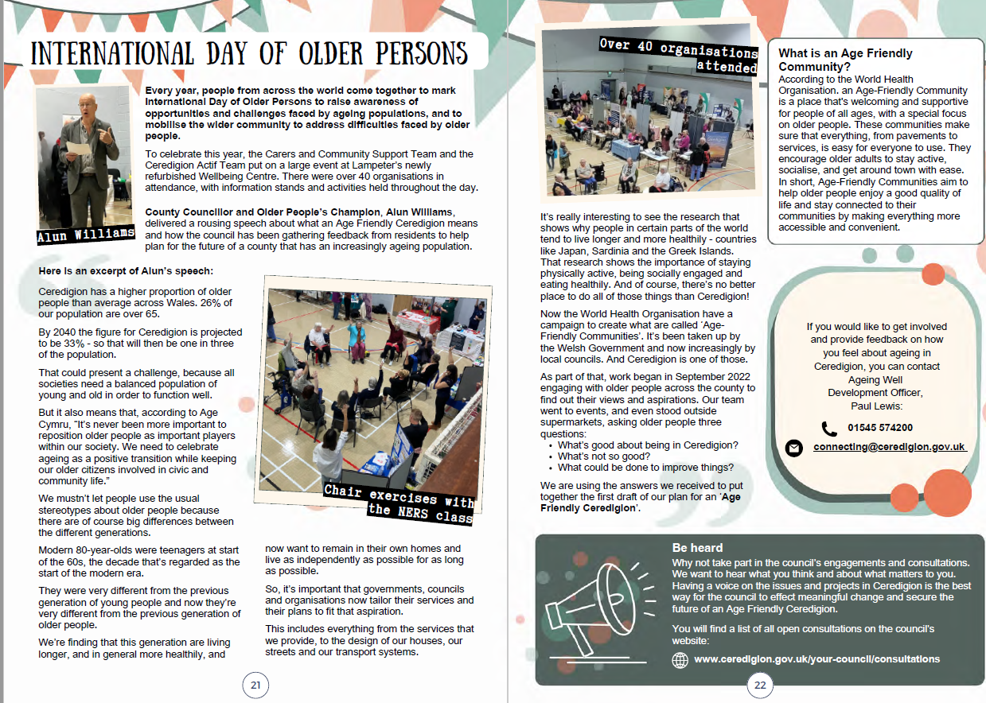

In October 2023, we celebrated International Older Persons Day.
(and selected the logo!)

Slide 7

In December 2023, we joined the Age Friendly Community of Practice, set up by the OPC for all Local Authorities in Wales to share best practice, innovate and collaborate.

Slide 8

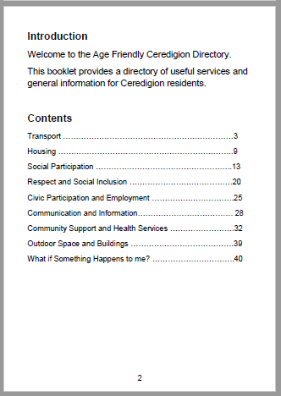
Using the details of organisations that supported us with IOPD 2023 we set about pulling together an Age Friendly Ceredigion Directory for distribution around the county in
April / May of 2024.
“ Thought the booklet was a brilliant idea lots of useful information. ”
“ Excellent booklet, does its job. ”
“ You very kindly dropped off 25 copies of the ‘Age friendly Ceredigion directory’ a couple of weeks ago, as anticipated with a mainly elderly population they have gone down exceedingly well and we do not have any left. ”

Slide 9
While waiting for the Age Friendly Directory to be published, January- April 2024 we carried out a Walkability Audit of Ceredigion
(29 Towns and villages around Ceredigion) and recently we completed an audit of Accessibility to Public Buildings from June - August 2024, which we developed ourselves and will share with the Community of Practice once evaluated.
Using the Irish Walkability Tool (recommended by the OPC), we assessed the following:
Footpaths
Facilities
Crossing the road
Road user behaviour
Safety
Look and feel
Outside the school gates

Slide 10
In December 2023 we recruited a Community Group Facilitator
To support AW Officer and AW lead with the AFC initiative
Co-produce support and information with CAVO for Community Groups
Develop a training and support suite for Community Groups
Advise and collaborate with Community Connectors in supporting Community Groups

Slide 11
But how could it work?
What would it be like?
A community-led network of Citizen Representatives and Community Groups, supported by ;
The Carers and Community Support Team
Age Cymru Dyfed
The Older People’s Commissioner
Ceredigion Association of Voluntary Organisations
With key stakeholders at hand to support on specific issues.

Slide 12
Intergenerational
Inclusive
Cross border
Through age

Slide 13
Timeline
24 / 25
May - September 2024
- Arrange launch event, engage with citizen representatives & group leaders, develop workbook, meet with stakeholders, develop AFC Flyer.
June - September 2024
- Develop version 2 of the Directory.
June 2024
- Initial meeting 25.6.24, Penmorfa, Aberaeron. Set up website tile on CCC website page.
August 2024
- Follow up meeting - 29.8.24, Penmorfa, Aberaeron and via Teams. Submit application to WHO
September 2024
- Launch event - 30.09.24, Council Chambers, Penmorfa, Aberaeron.
November 2024
- newsletter, methods of communication, work with community leaders to develop Age Friendly Communities. Develop Age Friendly Plan. Weekly feedback meeting with Team Manager & Corporate Manager. Ceredigion wide AFC Forum.

